Slide 1
Train Ticket Booking

Slide 2
Business Requirements
The Trains should be fetched from database using train number.•
Travel date should be after current Date.
The PNR number should be auto-generated by adding first character of source station, first character of destination station, travel date(yyyymmdd) and a running counter starting from 100.
The ticket Fare for each passenger is calculated using the following rules.
The file name for storing the generated ticket should be the PNR Number.

Slide 3
Application overview
This is an user friendly application which involves in booking a train ticket and printing that ticket to a File.
The application takes train number and passenger details as input.
The details of all the trains available for booking is stored in a database. The contents in the database of trains table is as follows: Train number, Train Name, Source Station, Destination Station and Ticket Price.
When the booking is successful then the ticked will be generated and will be written in a file.
That file contains the train details and passenger details with total price.

Slide 4

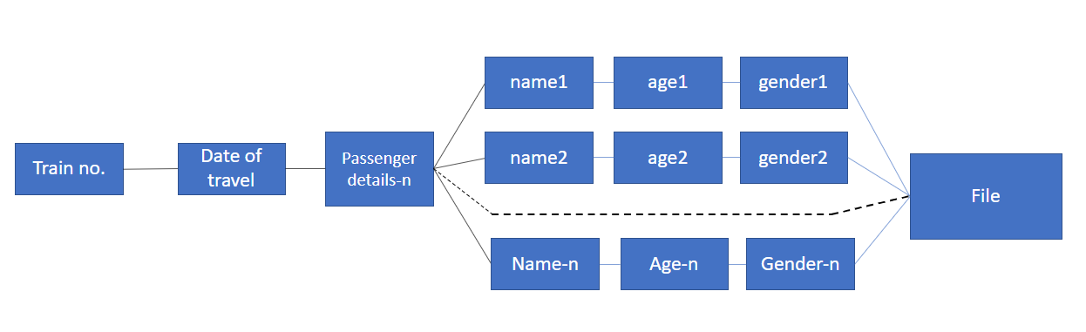




Structure of application

Slide 5
Implementation:
User will enter the train number.
User will enter the train number.
a. find Train():
If, the train number is entered, it will check for the train number in database.
If, the train number is not available it will print as "Train not found".

Slide 6
2. User will enter the date and enter the passenger details.
1. dateValidatingModule(userDate)
>If user Date is after the current System Date >>addPassengerDetails() Or else >Ask User to re-enter the valid date 2.addPassengerDetails() > In this module passenger entered details will stored in the TreeMap<> >Tree Map will provide us a easy method to sort the data as we want. >key-passenger details >value-calculated Fair for each user

Slide 7
3. PNR will be generated for a ticket.
generatePNR Method:
This methodwill be helpful for generating PNR number As mentioned in business requirements.
This is a unique number and also it acts as a booking number for every ticket.
getCount Method:
This method will be helpful for getting running counter.
This method is required for generating the PNR number. Count value will be incremented for every ticket

Slide 8
4.Calculation fare of each passenger and total price.
Based upon the business requirements the fare of each passenger is calculated as follows:
1.Kids who are aged below 12 their fare will be 50% of the ticket price.
2.Senior citizens who’s age is above 60 their fare will be 60% of ticket price.
3. 20% discount will be given to women's.
A method farecalculation() is coded for calculating fare as mentioned in above.
A method totalfare() is used to calculate the total price

Slide 9
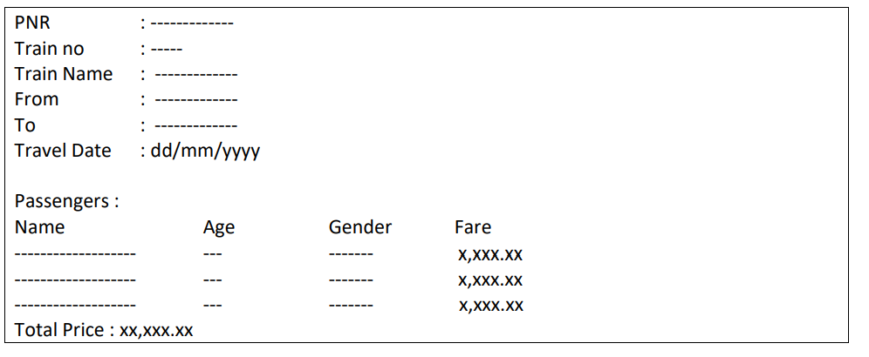
5. Generate ticket and write the ticket details into a file.
a. generate Ticket():
Here in this method string builder concept is used append all details of train and passenger as per given template
b. write Ticket():
In this method the input will be the instance of string builder which will written on the file with PNR number as its file name.

Slide 10
6. Integration of all modules.
As mentioned in business requirements the train table has been created.
All basic POJO classes are maintained.
All individual modules/methods are integrated in single class.
Application flow is maintained in main UI.

Slide 11
THANK YOU

